Slide 1

Knowledge Management Initiative: Feedback Session
Notes:
At most 2 minutes into workshop

Slide 2

Session Overview
Information and context for project
Write down questions/hold them for the end of this section
Guided feedback conversation
Notes:
5 minutes
Introductions
Session Overview
This is a brief overview of how the session will go today. as we go through the information and context, there will be a lot for us to share. Please save all questions for the end of that session.
After any clarifications, we will then have a guided feedback conversation.

Slide 3
Role of Organizational Learning
Membership
Julia Nicholson(lead)
Bill Fricke
Alex Lam
Csea Leonard
Sunny Olsen
Ashley Sears
Maria Julia Sorrentino
Committee housed within People & Culture Council
Tasked with knowledge management initiative
Addressing finding from the climate survey
“Institutional knowledge transfer, documentation. Answer the following:
What are the commonalities, what is the foundational piece versus the positional piece.
How/where/ownership: How institutional knowledge is stored and shared”
- People & Culture Council Charter
Notes:
3 minutes
The Organizational Learning Committee is withing the People and Culture Council in the new Shared Governance. The People and Culture committee was also tasked with addressing the findings in the climate survey around knowledge management:
Survey question: Information I need about internal college processes is easy to find. 44% of employees disagreed with this statement
This group is tasked with the knowledge management initiative, as listed in our charter. This includes knowledge transfer, documentation, and where institutional knowledge is shared.
In summary, this group has been put in charge of the process.
Additionally, in the recent campus climate survey, people shared that they had some trouble finding information.

Slide 4



Scope of Knowledge Management Initiative
Website
Public-Facing
Example:
Offered Benefits
Intranet
Internal, Employee Facing
Example:
How to sign up for benefits
Individual Work
Unit or Individual Facing
Example:
How to administer benefit plans
Notes:
5 minutes
Scope Clarification:
We want to be clear about what knowledge is within our scope. Using the topic of "benefits" is a helpful way to distinguish what we are talking about by dividing things into three buckets
Bucket 1 is our public-facing information. For benefits, this would mean our offered benefits.
Bucket 2 is internal, employee-facing - this would include information like how to sign up for benefits.
Bucket 3 is individual or unit facing. This includes "behind the scenes" things like how to administer benefit plans in the system.
We are only focusing on bucket 2 – internal, employee facing knowledge. This includes:
Content hosted on the current intranet
Committee pages and group sites
Other resources currently linked in myClackamas
Not included:
The public-facing website
Any individual work, including if faculty want to use Google for their own course work
Moodle

Slide 5
Recommendation Elements
System Selection
What (single) platform should we use?
Implementation
How will we get the system up and running?
Ongoing Support
Who will oversee and maintain the system?
Oversight
Who will gather ongoing feedback?
Notes:
3 minutes
Recommendation Elements:
To help you see more about our process, these were the four elements we were considering when selecting which system to replace our current intranet:
System Selection: What (single) platform should we use?
Implementation: How will we get the system up and running?
Ongoing Support: Who will oversee and maintain the system?
Oversight: Who will gather ongoing feedback?
We have plans for each of these areas moving forward as part of our proposal and we need your feedback, which we will gather here later today.

Slide 6








Criteria for System Selection
Existing platform
End user navigation features
Robust search tools
Unit ownership of content
Versioning
Security & access features
“Out-of-box” platform
Web accessibility functions
Notes:
3 minutes
Criteria for System Selection:
These were the criteria we were considering when looking at which system to select.
End-user navigation: is it easy for people to use?
Robust search: can it search page and document text for answers?
Unit ownership of content: does the site have permission settings that will allow departments to update their own content
Versioning: Can we "roll back" to previous versions of each page
Security: can we manage security and access effectively
"Out of box" platform: no customization needed
Web accessibility: functions and built in features to support this. NOTE: not in charge of this effort but we want to ensure that the selected platform would support this initiative
As we considered each of these criteria, we talked with people from multiple departments to better understand how our selections would impact their work – both in the roll-out and in the ongoing system maintenance.

Slide 7

System Selection Decision
Reviewed Systems Included:
Moodle
NEOGOV
SharePoint
Sitefinity
Team Dynamics
Wordpress Server
Selected System:
SharePoint
Notes:
3 minutes
System Selection Decision:
Due to budget constraints, we only reviewed systems we currently have access to
We considered each of the systems on the left side of the screen and ultimately landed on SharePoint.
This was based off of all of the criteria give on the previous slide and our many conversations with stakeholders.
This is the selection we are proposing today - we are not discussing each of the reviewed systems. As we've shared, we've already done significant research and talked to many different people before landing on SharePoint.

Slide 8
RAZZLE DAZZLE PROTOTYPE TIME
Notes:
_____ minutes

Slide 9
Draft Roles and Responsibilities
Role | Implementation | Ongoing
SharePoint Co-Leads Julia Nicholson InSS Lead TBD | Oversee completion of project Train and support implementation team Communication with college | Provide ongoing training and support to editors Ensure consistency in page structure
Organizational Learning | Participate in inclusive planning Lead feedback sessions | Review requests for new pages, features, or structures Assist with ongoing assessment
ITS Support Team | Configuration of SharePoint environment and access groups Manage high-level system issues | Maintain system security and access Respond to tier 2/3 technical issues
Department/Unit Designated Editors | Attend training sessions Build initial version of department/unit pages | Serve as main contact for department/unit questions or edits Review and update content regularly
Notes:
10 minutes
Draft Roles & Responsibilities:
We are going to share more about our proposed roles and responsibilities. As we share with you, we want to remind you to please take any notes about questions you have and save them to the end of the presentation. We will have a guided conversation for you to provide feedback shortly.
SharePoint Co-Leads:
This will include the Learning and Organizational Development Manager (Julia) and a role in Instruction and Student Services (TBD).
These two positions will manage the full implementation, including project management, communication, training, and documentation
Organizational Learning:
This committee will serve as a check-point for ongoing feedback and inclusive planning/decision-making
This committee will also provide guidance and recommendations to the co-leads on updates and additions
ITS Support Team:
Assist with configuration and setup of the backend of SharePoint
Support for security and systems issues (active directory permissions, system downtime, etc.) - considered "tier 2/3"
Department/Unit Designated Editors:
The folks populating, updating, and reviewing content for their units

Slide 10
Feedback Conversation:
Ground Rules
Facilitators
Contain conversation to topics open for feedback
Promote full group engagement
Interrupt harmful conversations or comments
Participants
Speak about what you want to see (vs. things you do not want)
Speak from your own experience/perspective/role
Avoid personalizing comments
Notes:
7 minutes
Ground Rules:
We're now moving to the feedback section of our presentation today. We know that this is a new process, and change can cause some sense of anxiety. This is a normal response and we want to take a moment to name that if you're feeling anxiety or overwhelm, that's okay.
We wanted to start by sharing some ground rules to help us stay on track in our conversation.
Facilitators are going to:
Contain the conversation to specific topics. As we shared, we've already selected SharePoint, so we will not be talking more about the other system options. We will instead be focusing on impacts and needs related to SharePoint.
Some details of this project have not been fully answered since they will need to be discussed and planned within the implementation team. This includes a lot of the "in the weeds" questions or suggestions.
In general, he project team won't be "responding" to participant thoughts since we want to prioritize getting your ideas surfaced.
The Org Learning Committee will ensure that all questions and ideas are captured, and that they are addressed/answered in the formal recommendation or in implementation team communications.
Promote full group engagement. We want to hear from everyone, if possible. We will also have multiple modalities to provide feedback, including a virtual "idea box".
Interrupt harmful conversations or comments. One of the main three themes we recently heard in the recent Campus Climate Survey is people sometimes communicate in ways that are mean or disrespectful. It is the role of us as facilitators to support you all in keeping communication kind and respectful.
As participants, you are going to:
Share about what you want to see, instead of only naming what you do not want to see. This helps us to vision what we can do together and work toward addressing your needs as users of SharePoint.
Speak from your own experience/perspective/role. To do this, you can use "I statements" such as "In my role, I would find it helpful if...", instead of "Many people who use SharePoint say...".
Avoid personalizing comments. This conversation is about a new system at the College, not about anything that is personal to any one person or department.

Slide 11
Feedback: Implementation
What information should live on SharePoint? What would you want to share with college employees?
How much time per month do you think your team could realistically dedicate to SharePoint implementation?
What would help your team stay engaged and make steady progress throughout the implementation?

Slide 12
Feedback: Maintaining
What metrics or indicators would help us know SharePoint is being used effectively?
What kind of governance or oversight do you think is necessary to ensure inclusive and comprehensive design in SharePoint?
What practices or habits do you think will help us keep SharePoint useful, organized, and relevant over time?

Slide 13
Feedback: Communication
How can we effectively communicate with the college about this project?
What information can we share to help your team understand how this will impact/benefit them? What else do they need to know?
Who else should we talk to?

Slide 14
What's Next?
[DONE] Host engagement sessions for feedback
[In Progress] Incorporate feedback into handoff materials for implementation team
[DONE] People & Culture Council votes to move the recommendation forward
Formal recommendation document, as well as this presentation, will be uploaded to council website next week
[Next] Oversight Group votes for official approval of the recommendation
Employees may attend to voice any remaining feedback
[Once approved] Begin Implementation

Slide 15
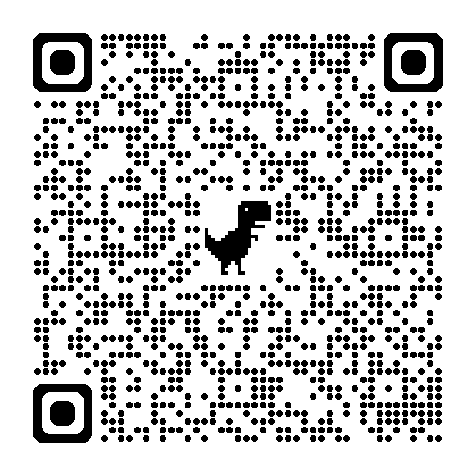
THANK YOU!
Things to think about as we move forward:
Where does your information currently live? What would moving your information take?
What position might be tapped to help with implementation?
How might their workload shift to accommodate this?
What can your team "pause" to prioritize this project?
Notes:
3 minutes
As this project moves forward, begin to think about your own work and the work of your department. This will help us have a smoother transition. Consider:
Where does your information currently live?
What position might be tapped to help with implementation? How might their workload shift to accommodate this?

